Slide 1
THE DESIGN PROCESS
Technical theatre

Slide 2
ESSENTIAL QUESTIONS
How is collaboration important in Technical Theatre?
How do the elements of Technical Theatre work together to realize the director’s vision?

Slide 3
THE DESIGN PROCESS
TO DESIGN IN THEATRE YOU MUST…
Be expressive - Express yourself through the guidelines of the script
Be unique - Bring something special to the stage
Be a problem solver – actors, directors
Be a team player – coordinate the needs of many areas
Be able to balance art and function
Be able to handle criticism
Be a visionary – see images, rather than words

Slide 4
CREATIVITY
Creativity is
“artistic or intellectual inventiveness”
What does that mean?
WHY IS IT DIFFICULT TO BE CREATIVE?
no chance to be
lack of inspiration
set standards

Slide 5
CREATIVITY
Components of Creativity
Fluency
  To produce many ideas; verbal & non verbal
Flexibility
  Different approaches to problems
Elaboration
  Adding details to an idea
Originality
  Uniqueness; nonconformity of thought or action

Slide 6
THE DESIGN PROCESS
7 STEP DESIGN PROCESS
Commitment
Analysis
Research
Incubation
Selection
Implementation
Evaluation

Slide 7
THE DESIGN PROCESS
COMMITMENT
Commit to the project 110%
To the script first
To the concept second
If 2nd guess now, will 2nd guess entire process

Slide 8
THE DESIGN PROCESS
ANALYSIS
Script analysis
  1st reading – 1st impressions of script
  2nd reading – take general notes; inspirations
  3rd reading – details & mechanical info
Production Information
  Budget
  Schedule
  theater facility

Slide 9
THE DESIGN PROCESS
RESEARCH
Background Research
  Given Circumstances
Conceptual Research
  Solving production problems within the production concept.
  Devise several ways to meet each challenge.

Slide 10
THE DESIGN PROCESS
INCUBATION
Time to let the new ideas “hatch”.
Don’t “actively” think about it. Let it sit awhile and then come back to it.
SELECTION
Narrowing down your ideas into specific choices within the concept.
Think collectively.
Foresee the “big picture”

Slide 11
THE DESIGN PROCESS
IMPLEMENTATION
Stop planning and start doing
All design work must be completed.
EVALUATION
Takes place every step of the way and after the show is over.
What was the most successful?
What would you change?

Slide 12
THE DESIGN PROCESS
PRODUCTION STYLE
A manner of producing a play in which all production elements adhere to a common set of artistic/philosophical characteristics.
Must identify the PRODUCTION STYLE before developing a concept!

Slide 13
THE DESIGN PROCESS
PRODUCTION STYLE
Style is an impression – not reality
  a time period (Elizabethan, Medieval, 1920’s)
  est styles: Romantic, Expressionism, Industrialist
HOW DO YOU SHOW IT VISUALY ON STAGE?
Elements of Design
Principles of Composition

Slide 14
ELEMENTS OF DESIGN
Line
Shape
Mass
Color
Texture

Slide 15
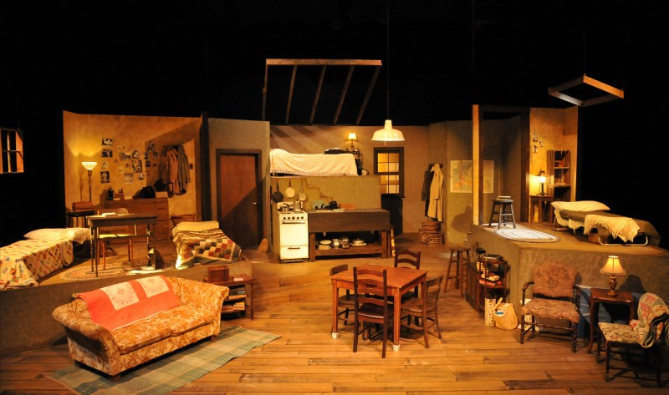
ELEMENTS OF DESIGN
LINE
angled
jagged
straight
curved
combination
The Diary Of Anne Frank

Slide 16
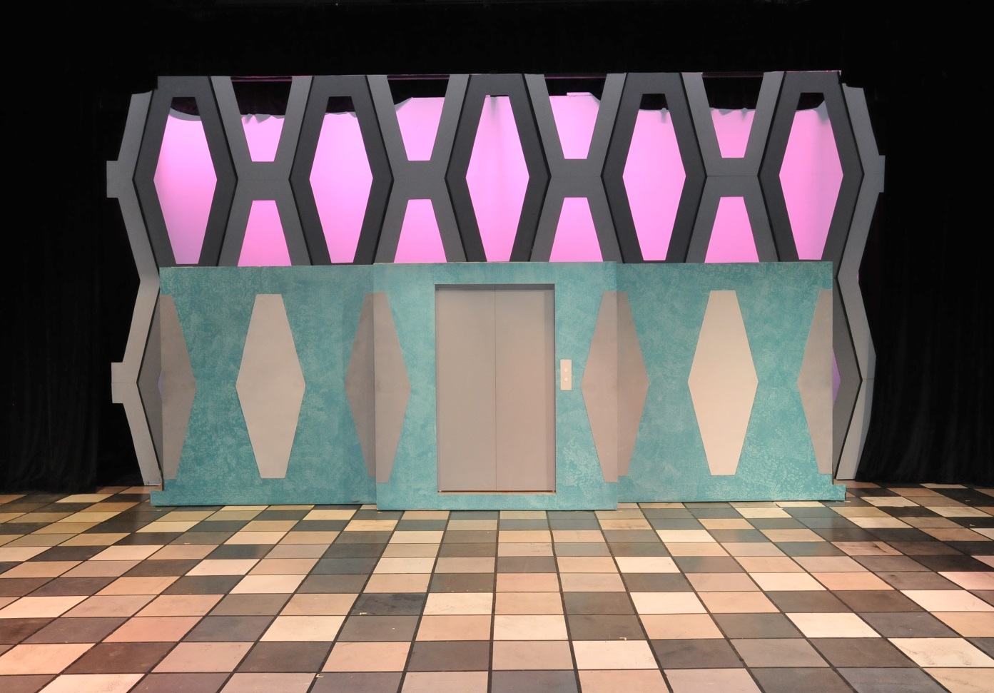
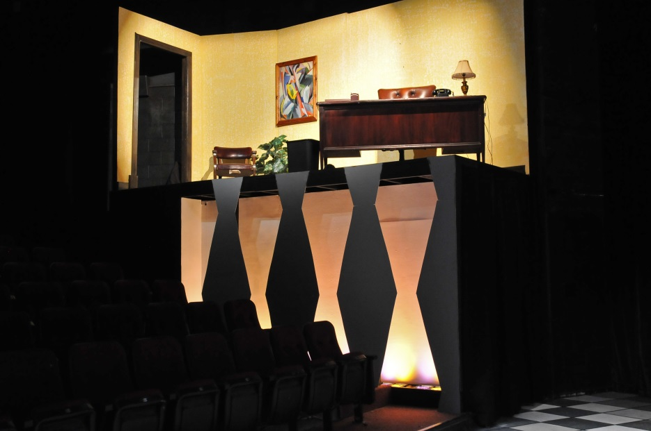
ELEMENTS OF DESIGN
SHAPE
A line that defines an enclosed space
outlines
silhouettes
reoccurring objects
symbols
How To Succeed in Business Without Really Trying

Slide 17
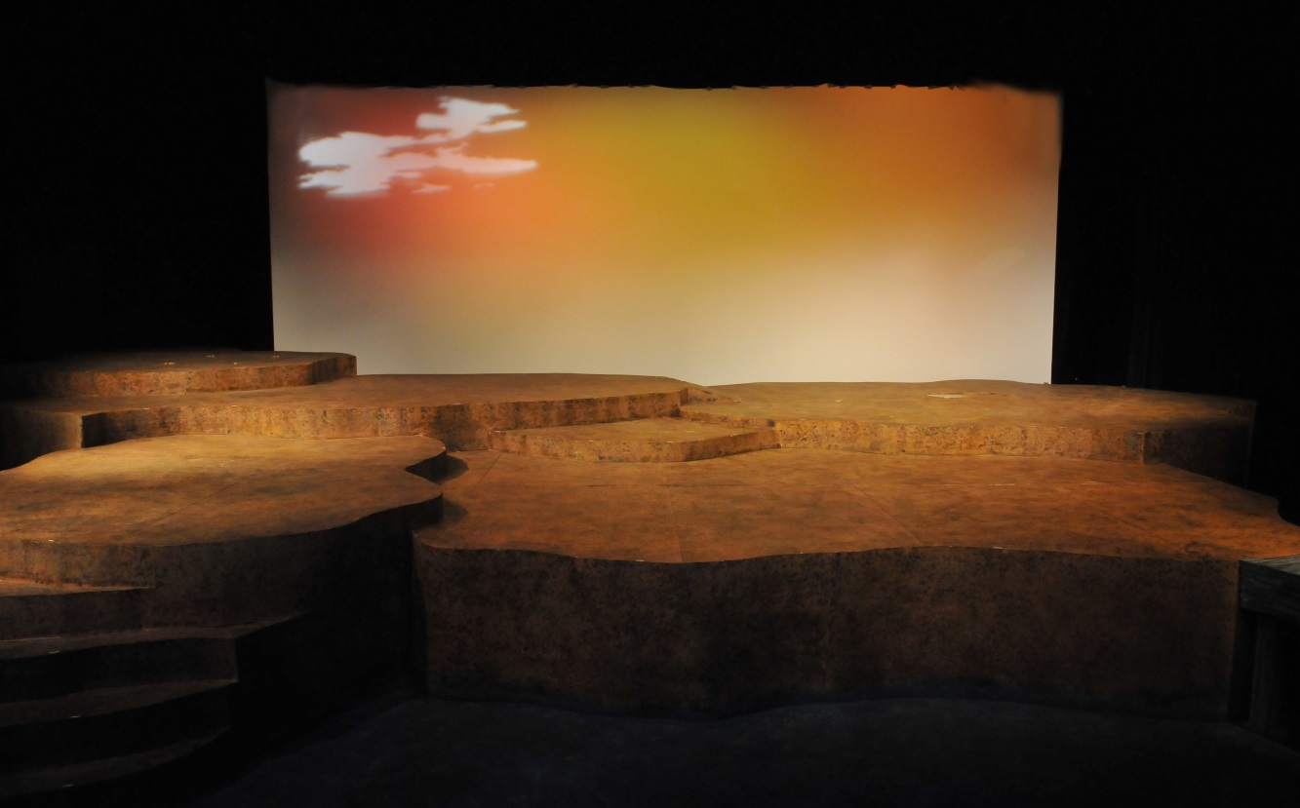
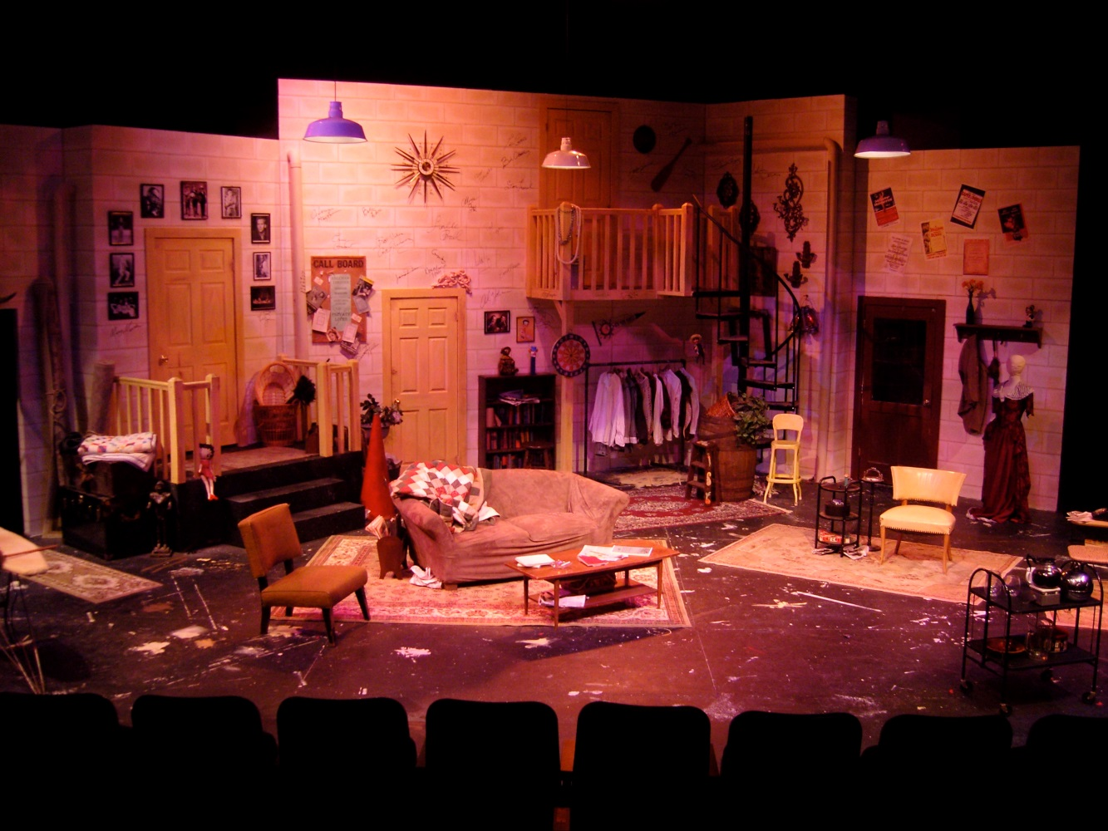
ELEMENTS OF DESIGN
MASS
Creates depth & space on stage
spatial arrangement of the stage
Chaotic, spacious or varied
heavy or light
The Diviners
Moon Over Buffalo

Slide 18
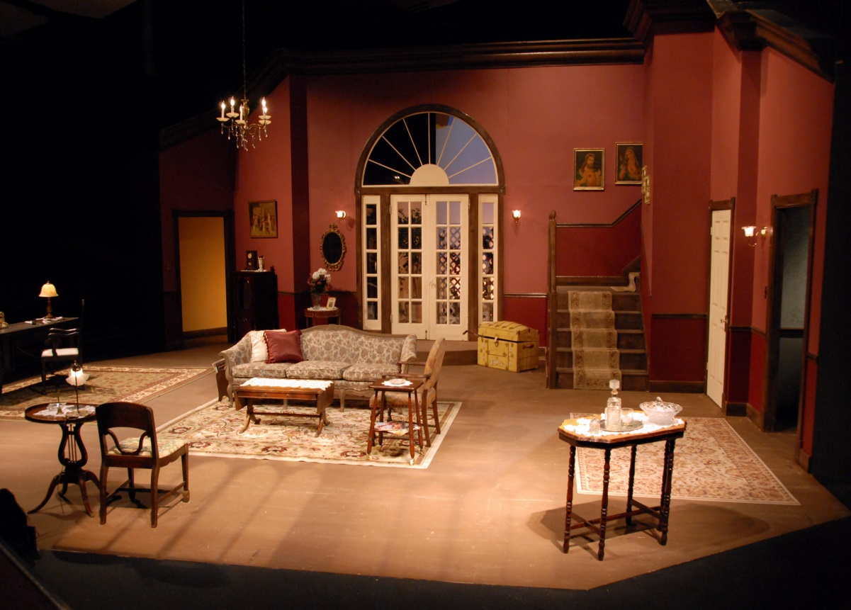
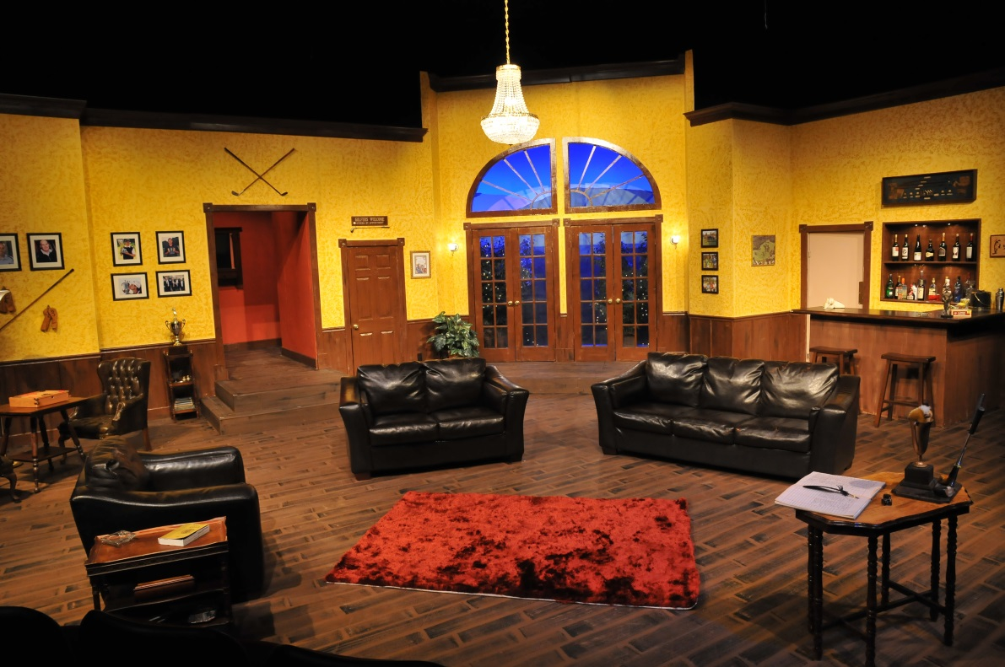
ELEMENTS OF DESIGN
COLOR
reoccurring colors
Do colors contradict or compliment the overall feeling or mood of the script?
See How They Run

Slide 19
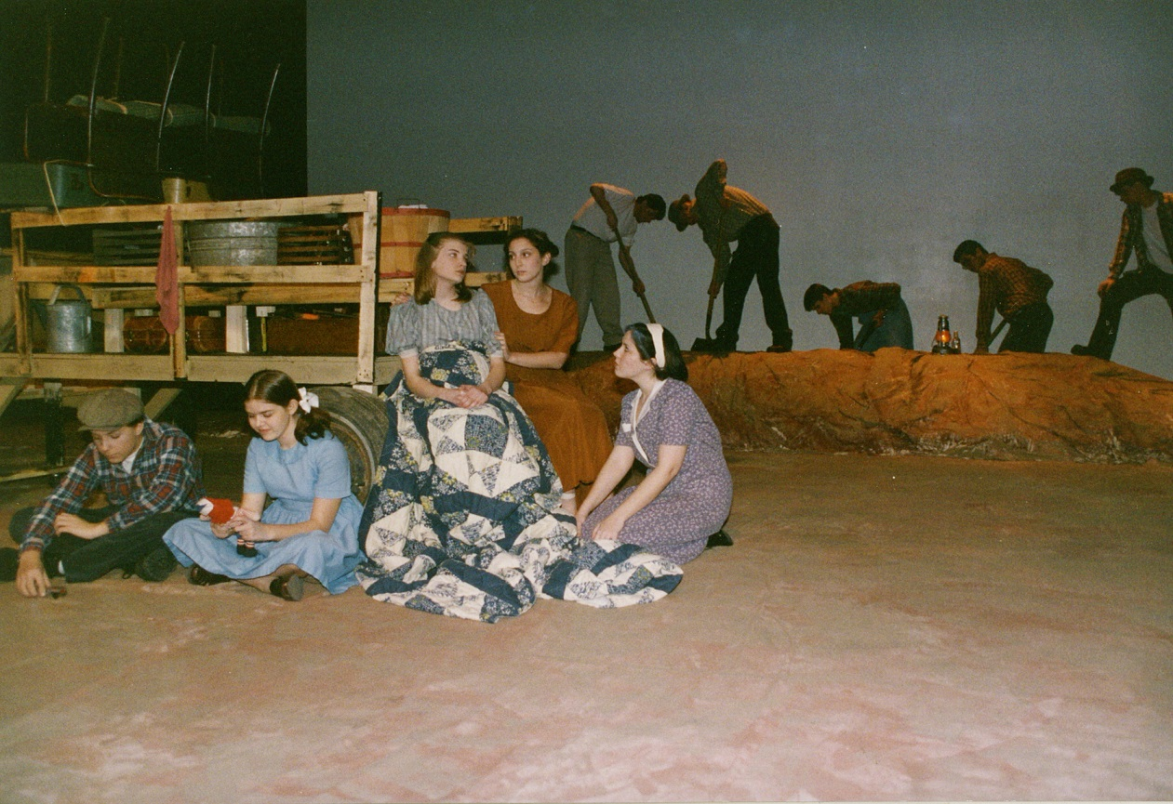
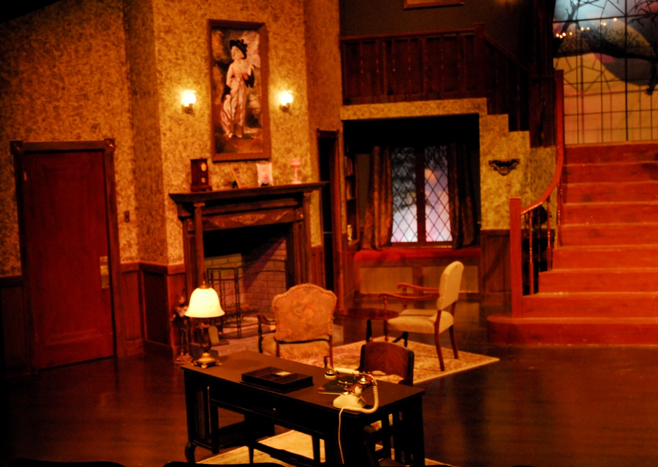
ELEMENTS OF DESIGN
TEXTURE
Can reflect mood, socioeconomic & time period
Hides seams/flaws
Creates depth
Visually interesting
Smooth = orderly, finished, sleek, elite
Rough= harsher, chaotic, poor, earthy
The Grapes of Wrath
The Mousetrap

Slide 20
PRINCIPLES OF COMPOSITION
Unity
Harmony
Contrast
Variation
Balance
Proportion
Emphasis

Slide 21
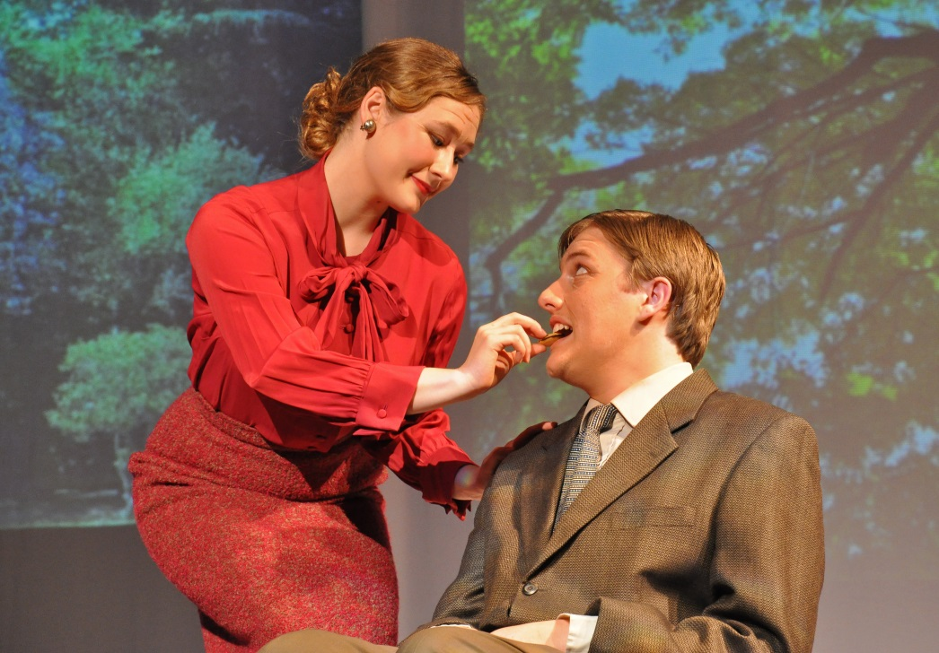
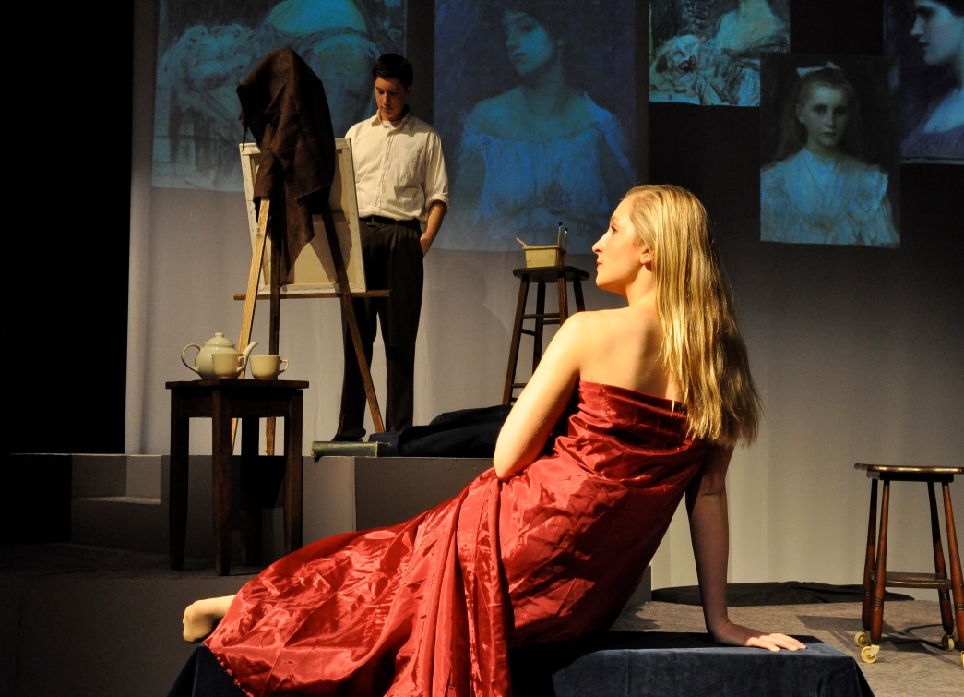
PRINCIPLES OF COMPOSITION
UNITY
What connects the show?
Theme
Color
Feeling
Shape
Character
An idea
Technical
element
The Prime of Miss Jean Brodie
Use of red to connect Sandy to Brodie; love, hot, sex, romance
Theme of Seduction
Use of Projection throughout show
Idea –Brodie in her “prime”, Sandy challenging her for it.

Slide 22
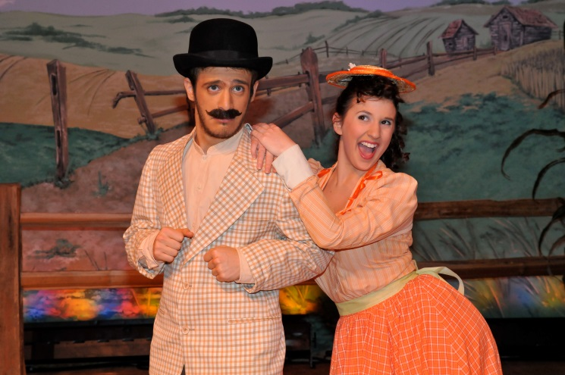
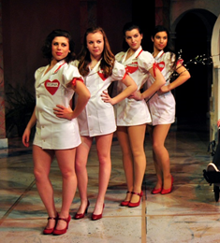
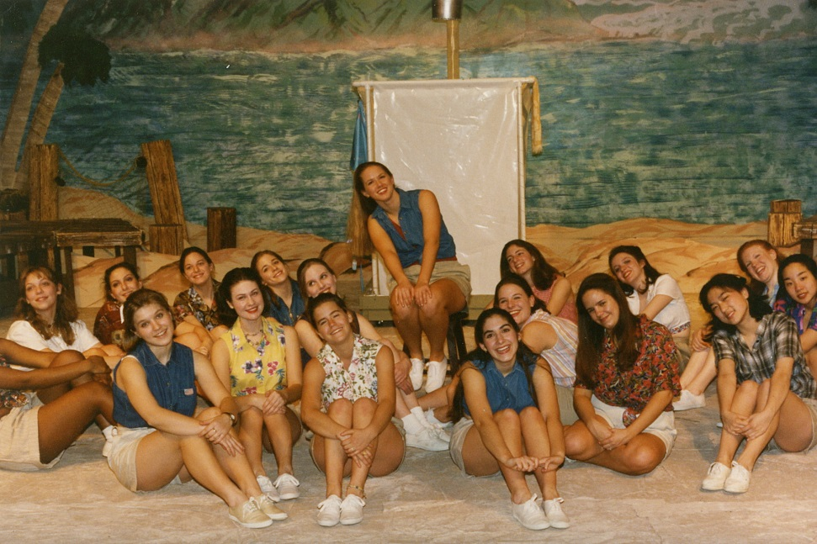
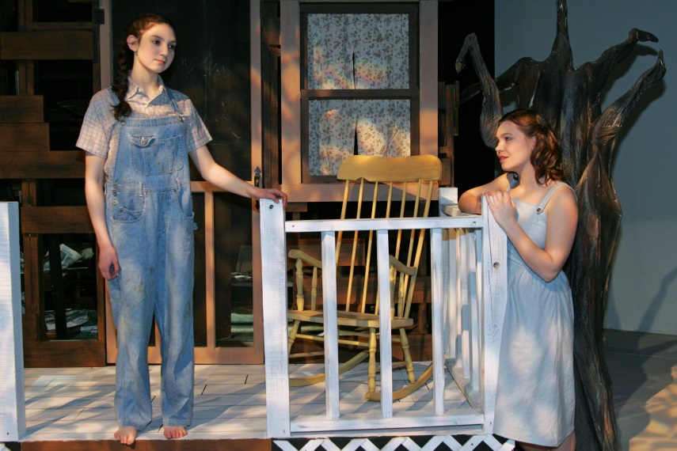
PRINCIPLES OF COMPOSITION
HARMONY
Harmonious
Aspects that compliment each other
Too much can become monotonous if over used
DRS, Oklahoma!
To Kill A Mockinbird,
South Pacific

Slide 23
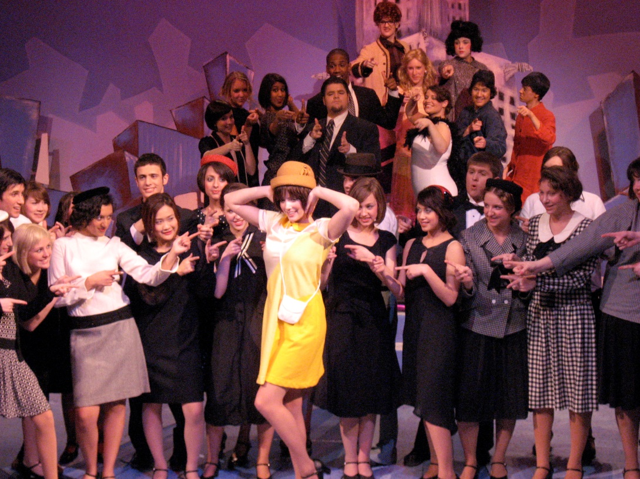
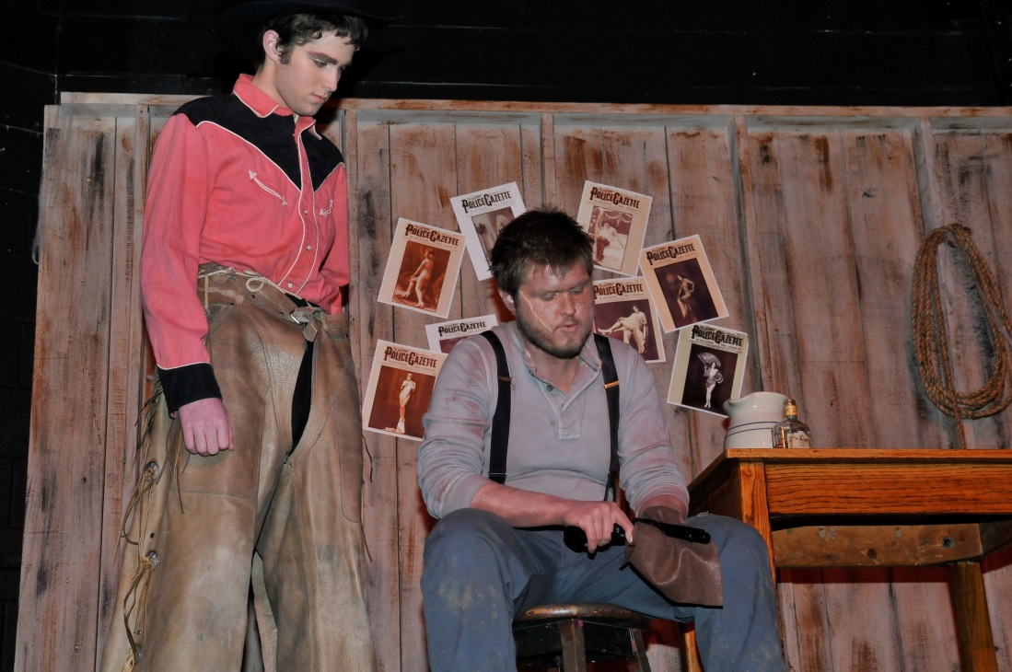
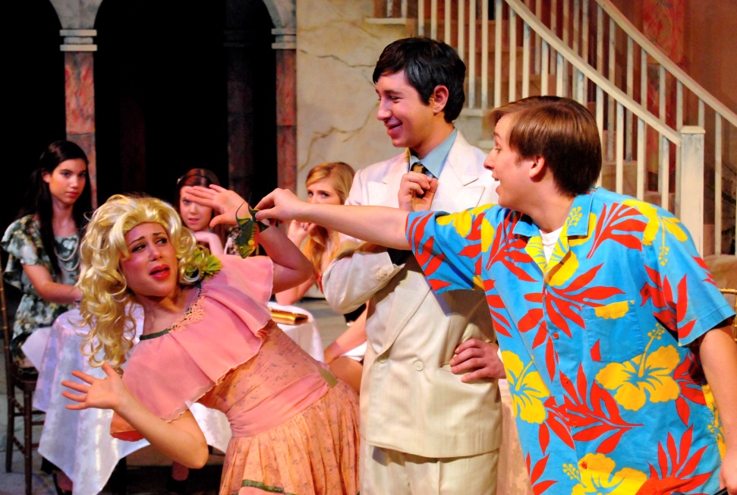
PRINCIPLES OF COMPOSITION
Millie
CONTRAST
contradicting your visual theme
Making a flamboyant character stick out
Defining differences between 2 types of things: wife/lover, good guy/bad guy, groups of people
Oklahoma!
Scondrels

Slide 24
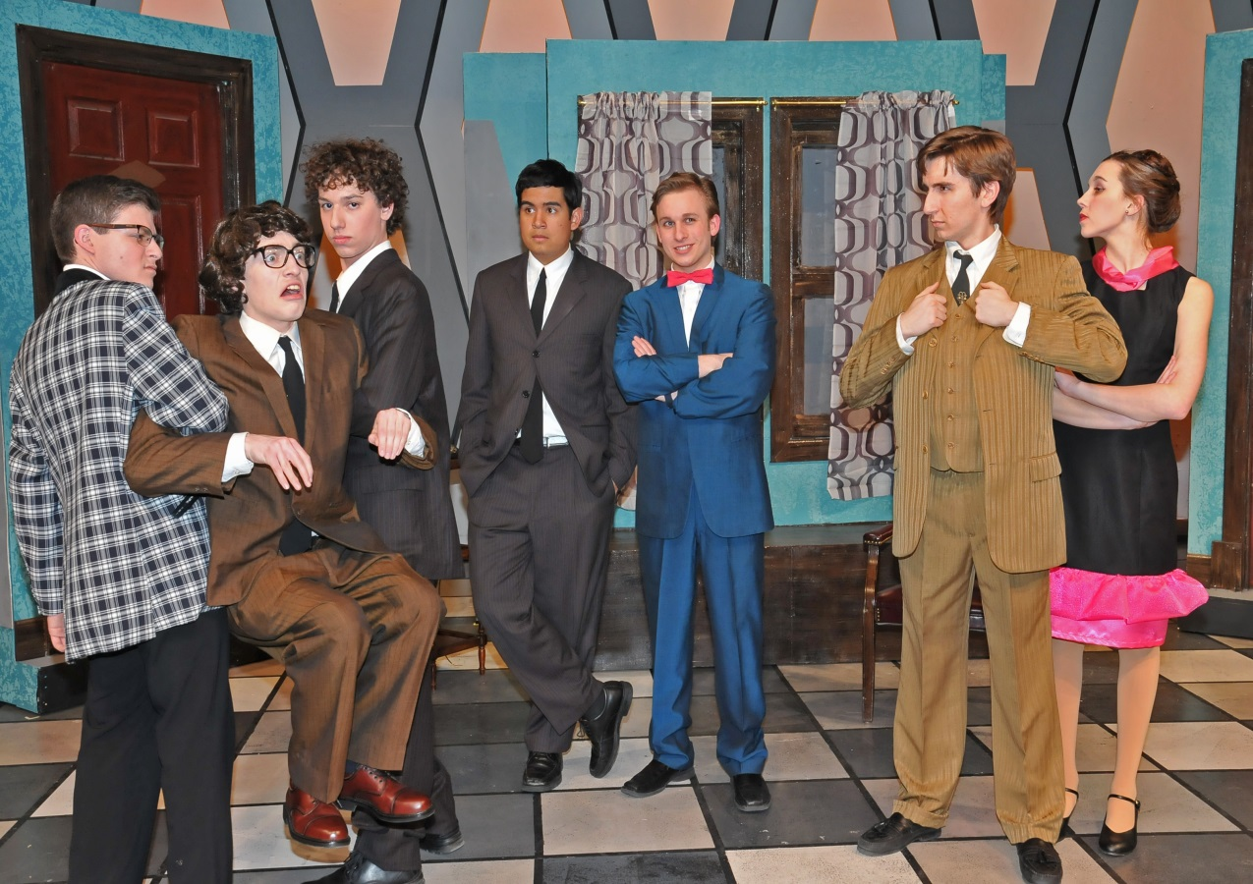
PRINCIPLES OF COMPOSITION
VARIATION
varying any of the design elements of a given pattern
Tool to balance out too much harmony
How To Succeed…
Red bow tie – 1. geometric, similar to set only sideway (variation); 2. red so gives contrast; 3. balances out all male chorus in dark suits, white shirts and black neck ties (variation)

Slide 25
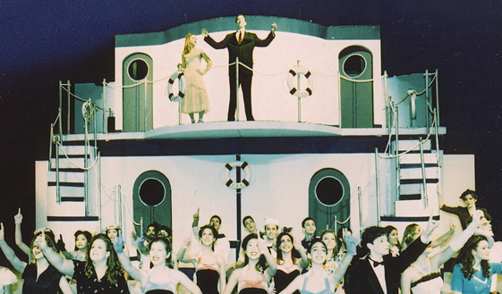
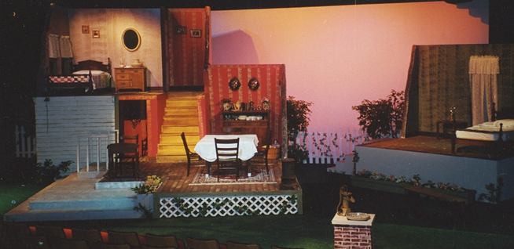
PRINCIPLES OF COMPOSITION
BALANCE
Symmetrical
Asymmetrical
Anything Goes
The Miracle Worker

Slide 26
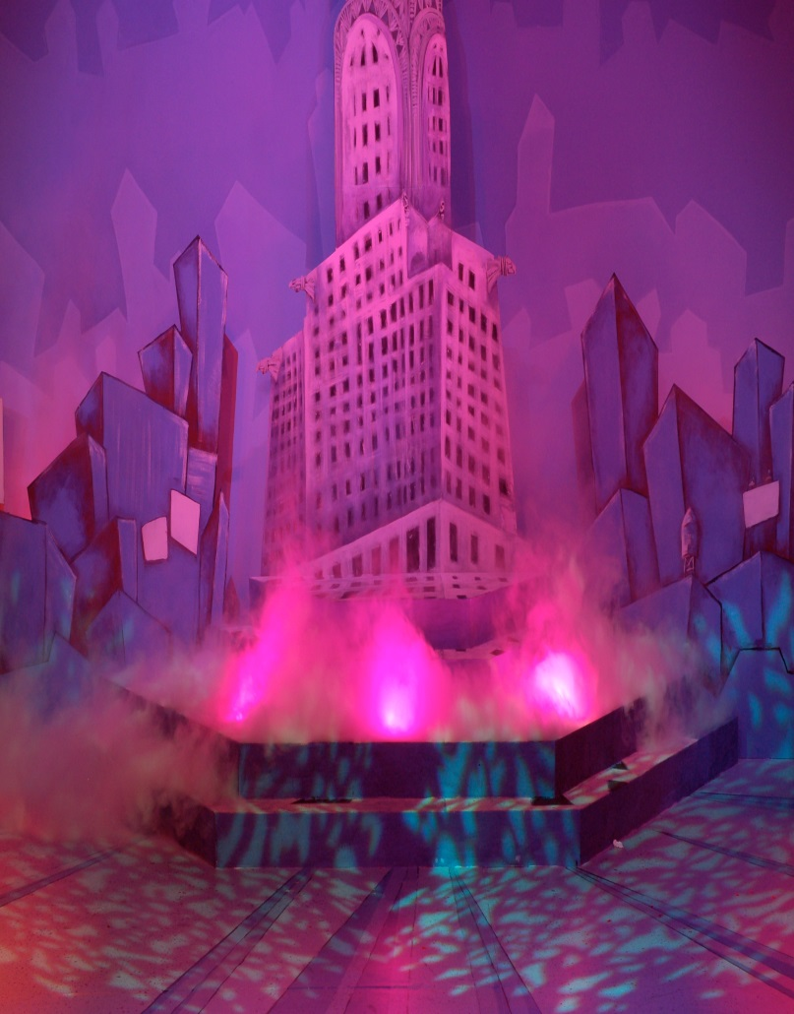
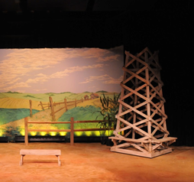
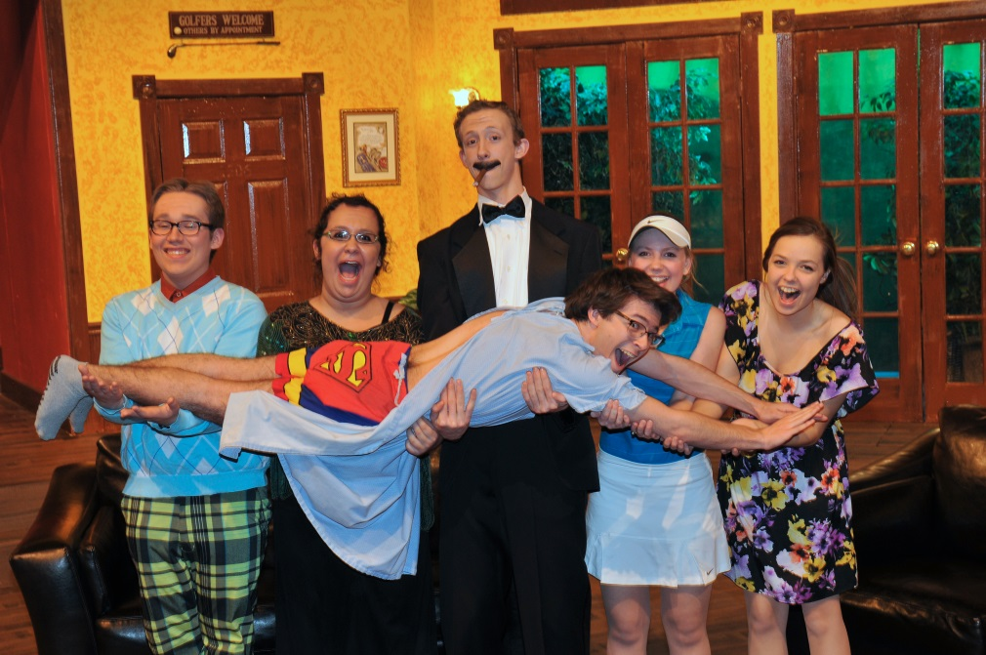
PRINCIPLES OF COMPOSITION
PROPORTION
The scale of one part of something to the other parts
  Skyscraper in low –lying neighborhood
Creates comedy
  Huge hat or bustle, tiny bow tie on a big guy
  Room too small for people
  Costumes too small
Oklahoma!
Thoroughly Modern Millie
Fox on The Fairway

Slide 27
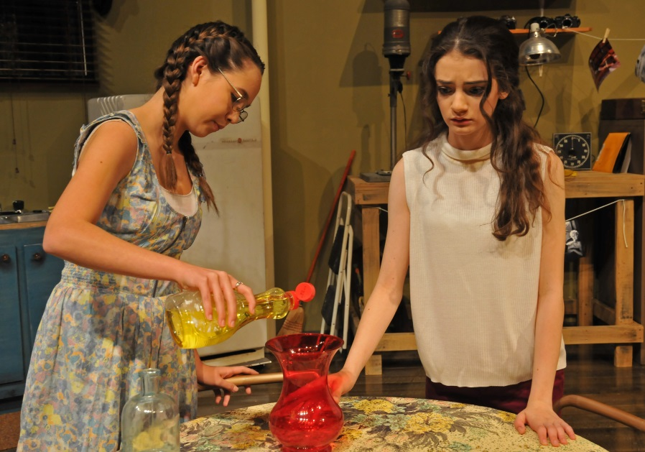
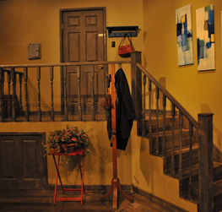
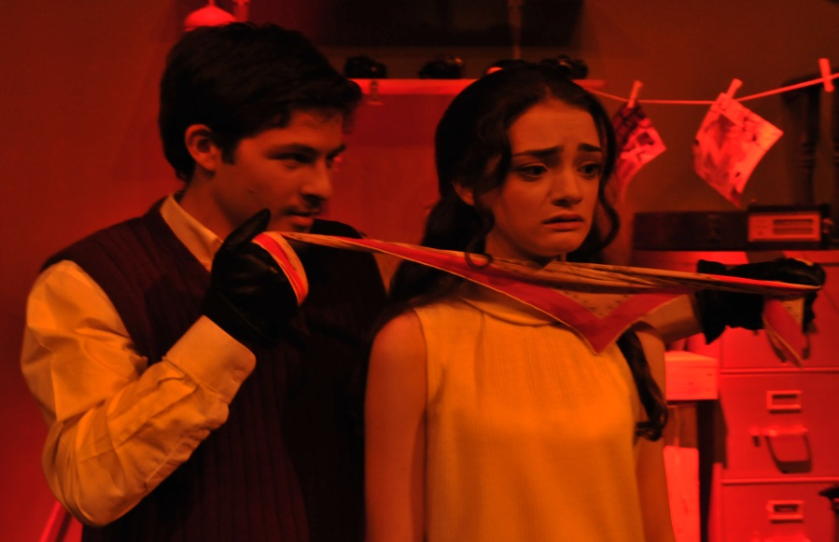
PRINCIPLES OF COMPOSITION
EMPHASIS
direct the audience’s attention
giving accent to:
  stage
  costume
  actor
  prop
Wait Until Dark

Slide 28
PRODUCTION CONCEPT
WHAT IS A PRODUCTION CONCEPT?
It is the central creative idea
that unifies all designing
aspects of the production

Slide 29
PRODUCTION CONCEPT
WHY IS IT IMPORTANT?
Unifies all the areas of technical design in a production
Allows all designers to work towards a common goal, so that all the pieces of the puzzle fit well together.
Allows a designer to have a place to begin designing from in which all his ideas can relate to.
Becomes a visual interpretation of the playwright’s words.

Slide 30
PRODUCTION CONCEPT
HOW IS A CONCEPT DEVELOPED?
A designer should take into consideration many aspects of the script before designing; including the:
mood and spirit of the play
the historical period
local and season of the play
personality of the characters
visualize themes - images and abstract thinking
You must unblock your thinking, overcome tunnel vision, avoid stereotyping and be selective.

Slide 31
PRODUCTION CONCEPT
WHAT ARE THE STEPS INVOLVED IN CREATING A PRODUCTION CONCEPT?
Analyze the GIVEN CIRCUMSTANCES.
Analyze the ELEMENTS OF DESIGN in relation to the script’s theme and idea.
Analyze the PRINCIPLES OF COMPOSITION in relation to the script’s theme and idea.
Take all the information gathered in steps 1, 2 and 3 and formulate the PRODUCTION CONCEPT .

Slide 32
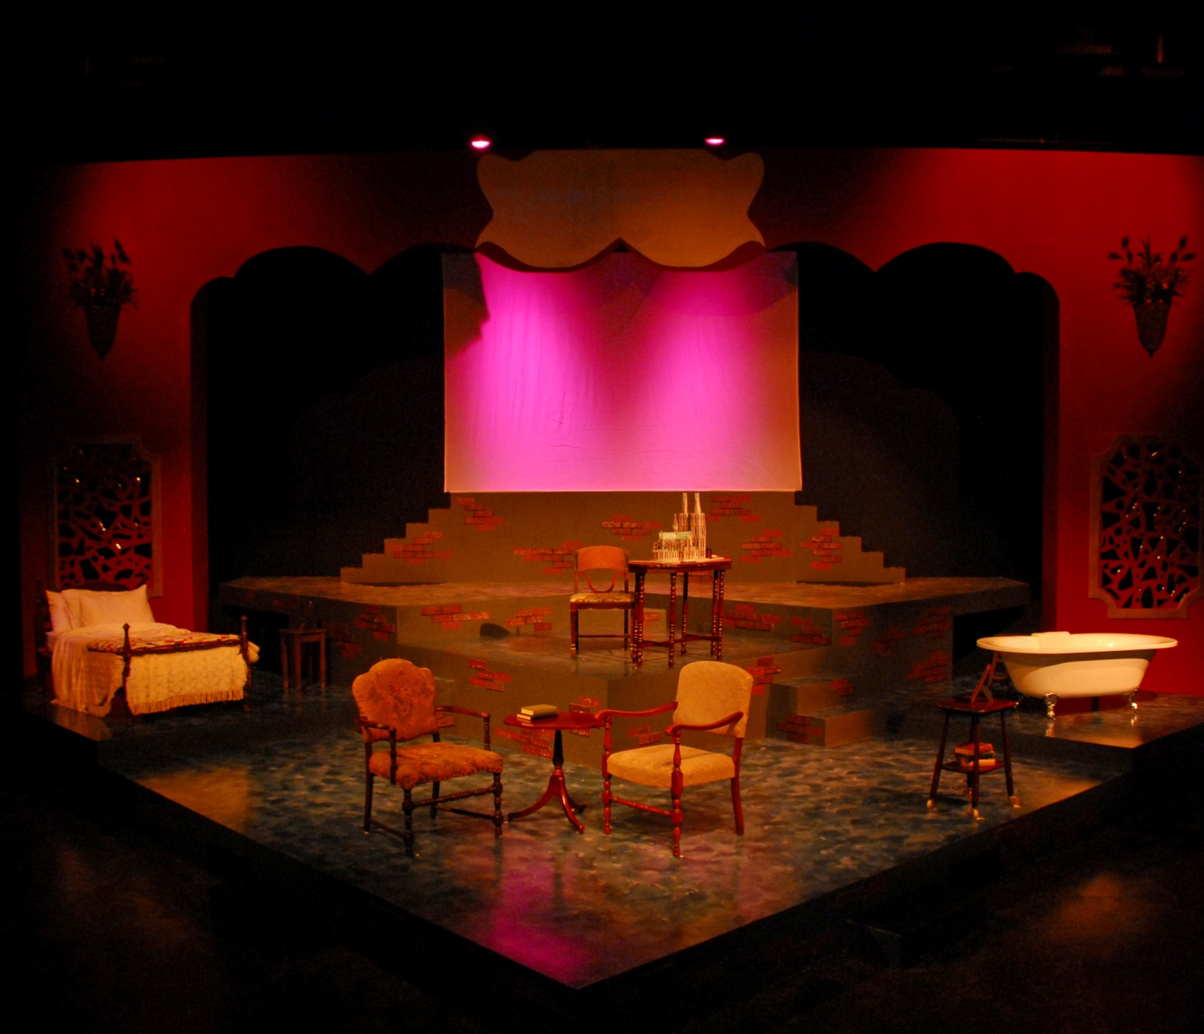
DESIGN ELEMENTS
THE ELEPHANT MAN
LINE- Everything is straight and angular within the confines of the Elephant Man’s world; the hospital, his room, the freak show where he originates from – a hard, desolate life, one way path to no where. Yet the proscenium arch is curved to represent the choices that still like with in each of us.
COLOR-muted grey tones of red and blue. Red to represent the death the Elephant Man is ultimately facing and blue for the tears, sadness and pain he feels with in. White will represent the innocence, vulnerability and peace the Elephant experience at that time or place.
SHAPE- Geometric; rectangles, squares

Slide 33
DESIGN ELEMENTS
THE ELEPHANT MAN
TEXUTRE- Mixture of smooth and rough to compare to the Merck's life . The grey with incomplete bricks represents his life – unfulfilled; only ½ lived. It is rough and left as a matt finish to represent the lower class of the hospital and freak show. The inside hospital room is sponged textured with a high gloss Polly sheen so that the he and the items will reflect off the floor – a reminder of who he is and where he is. A smooth finish to represent the higher status of his room.
MASS - The overbearing proscenium arch hovering over the Elephant Man as if to say he is and will forever be “on display”. Feels heavy and is massive in comparison to the characters, as if they are trivial.

Slide 34
PRINCIPLES OF COMPOSITION
THE ELEPHANT MAN
HARMONY-harmonious overall, warm, earth tones
CONTRAST- The proscenium arch provide contrast to the angular lines and harsh mood.
VARIATION-(royalty costumes)
BALANCE- The show goes from asymmetrical to symmetrical just as Merck's life does the same; goes from being out of controlled and part of a freak show to being balanced, with purpose as he is taken in by the doctor and given a new life. Here you see the set balanced and symmetrical.
EMPHASIS- areas with emphasis include: Up center scrim, proscenium arch projections. Royalty, freaks, death moment

Slide 35
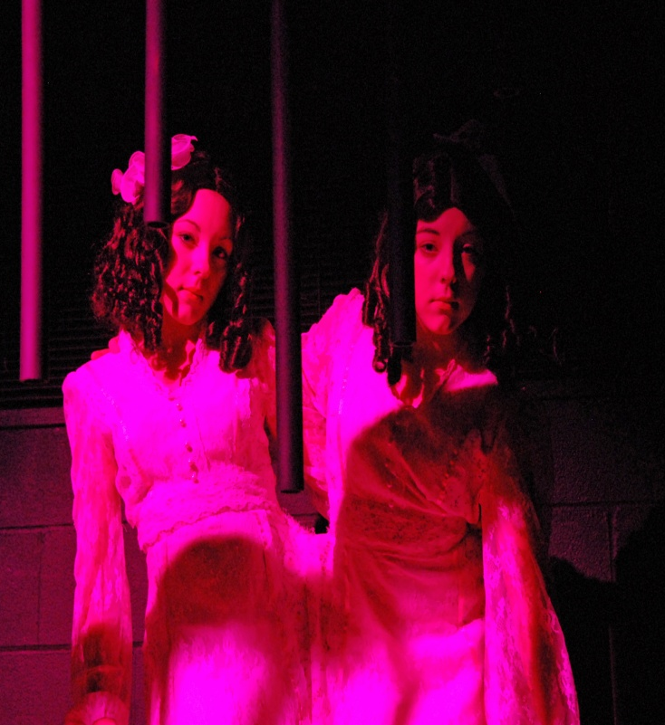
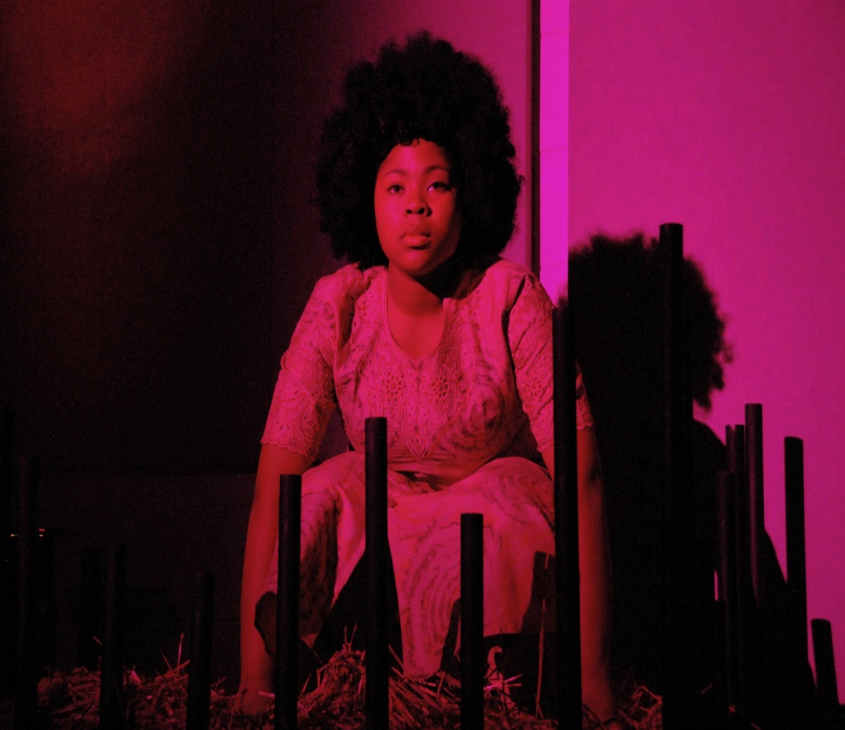
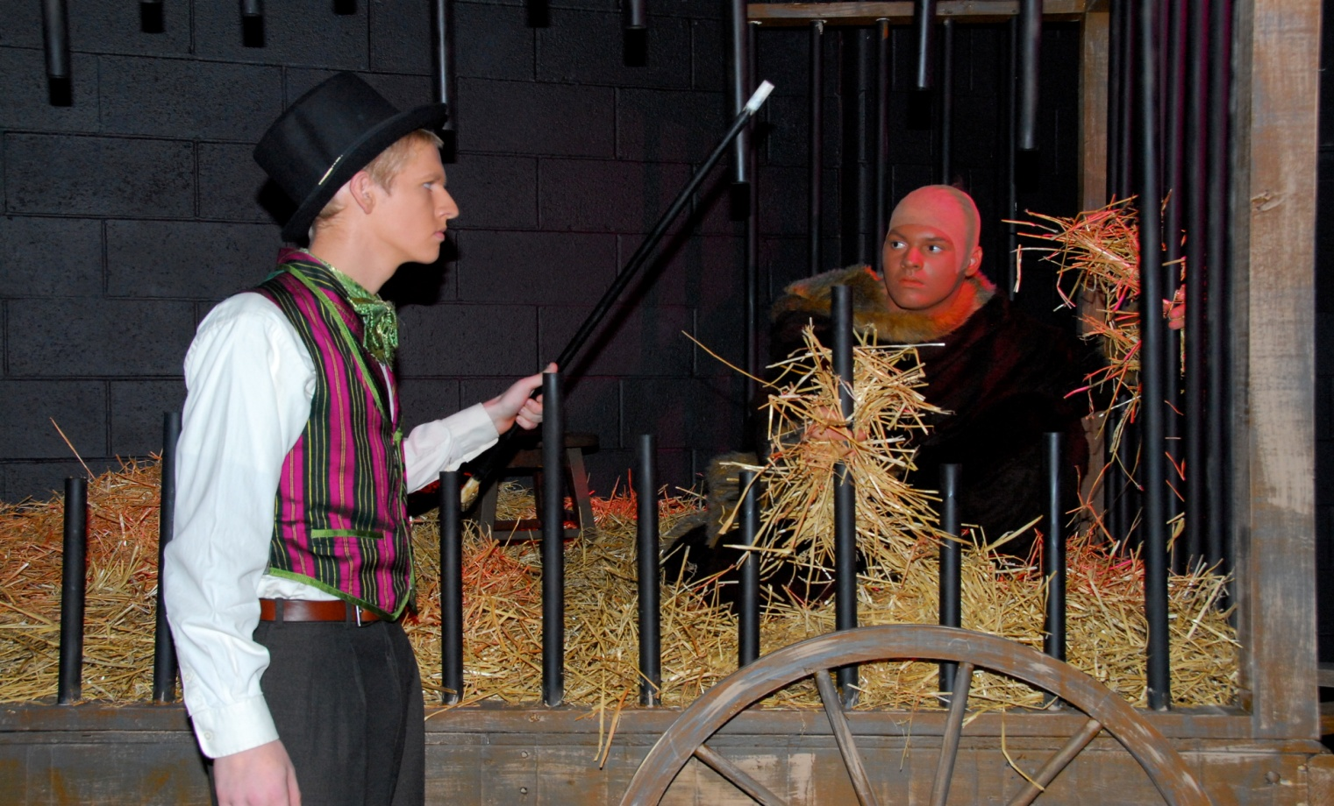
UNITY reality vs. illusion
To further bring the audience closer to the action, Freaks were placed throughout the house and on the side stages.
Make-shift wagons were built with disjointed bars

Slide 36
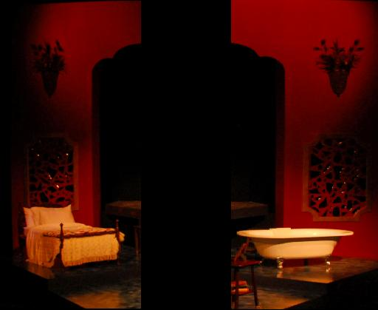
UNITY &
CONTRAST
THE ELEPHANT MAN
UNITY
reality vs. illusion
The broken mirrors placed on either side of the proscenium for the audience to look at themselves but in the same manner in which Merrick must see himself – in a broken, distorted way.
CONTRAST
hard vs soft
The mirrors ,floor and other items are hard vs the feathers on the wall to show contrast… much like the harsh realities that face Merrick everyday (physically), mentally, John is soft, kind, sweet and giving.

Slide 37
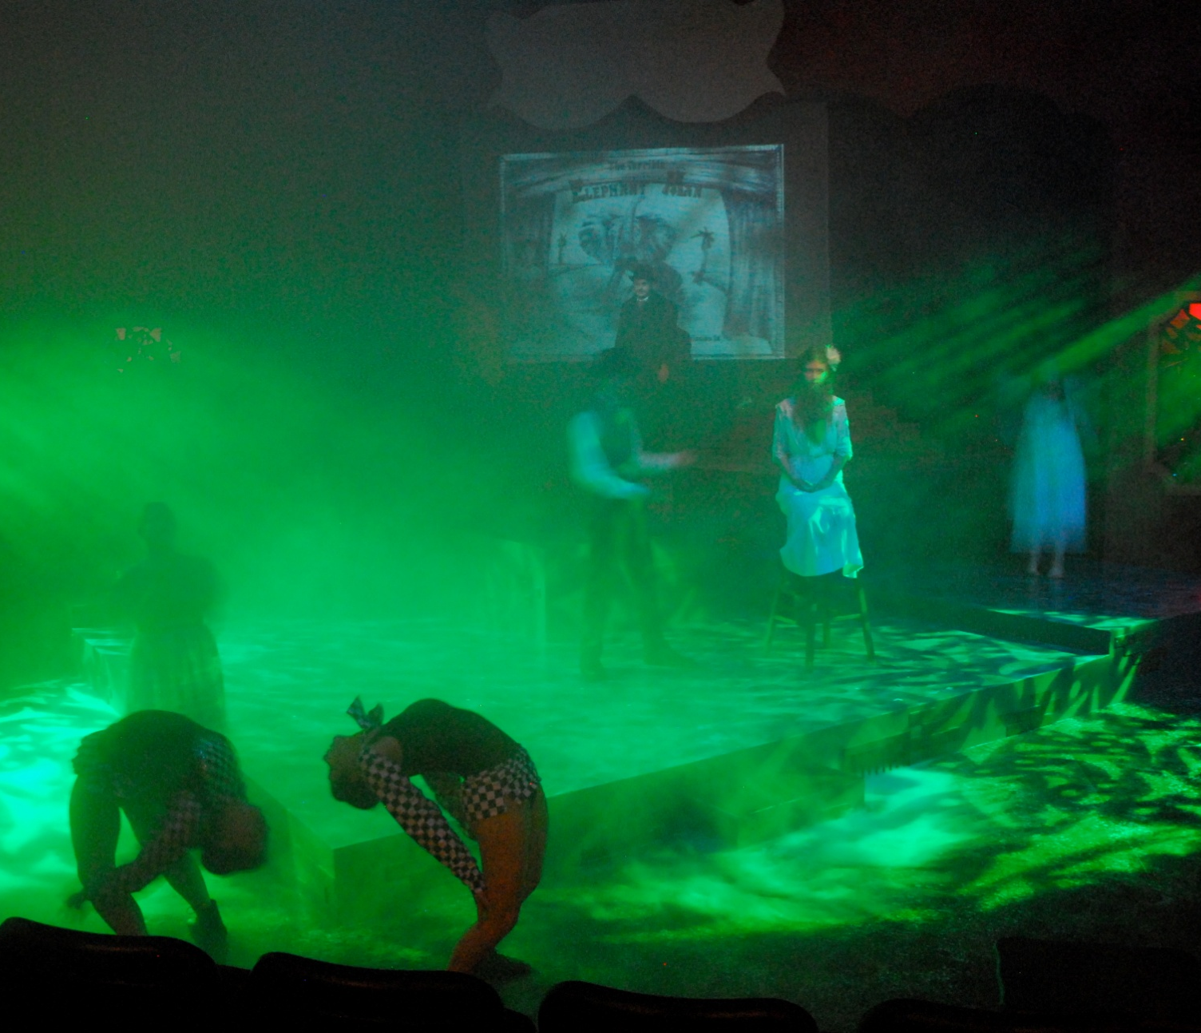
PRODUCTION CONCEPT
THE ELEPHANT MAN
LINE, SHAPE, TEXTURE, COLOR
During the Freak Show, gobos provided geometric shapes giving it a very rough texture. It’s a harsh environment, dark and scary. Fog pumped through pipes in the stage created an ominous mood as it cheeped through the green light which bled down in sheets of lines.

Slide 38
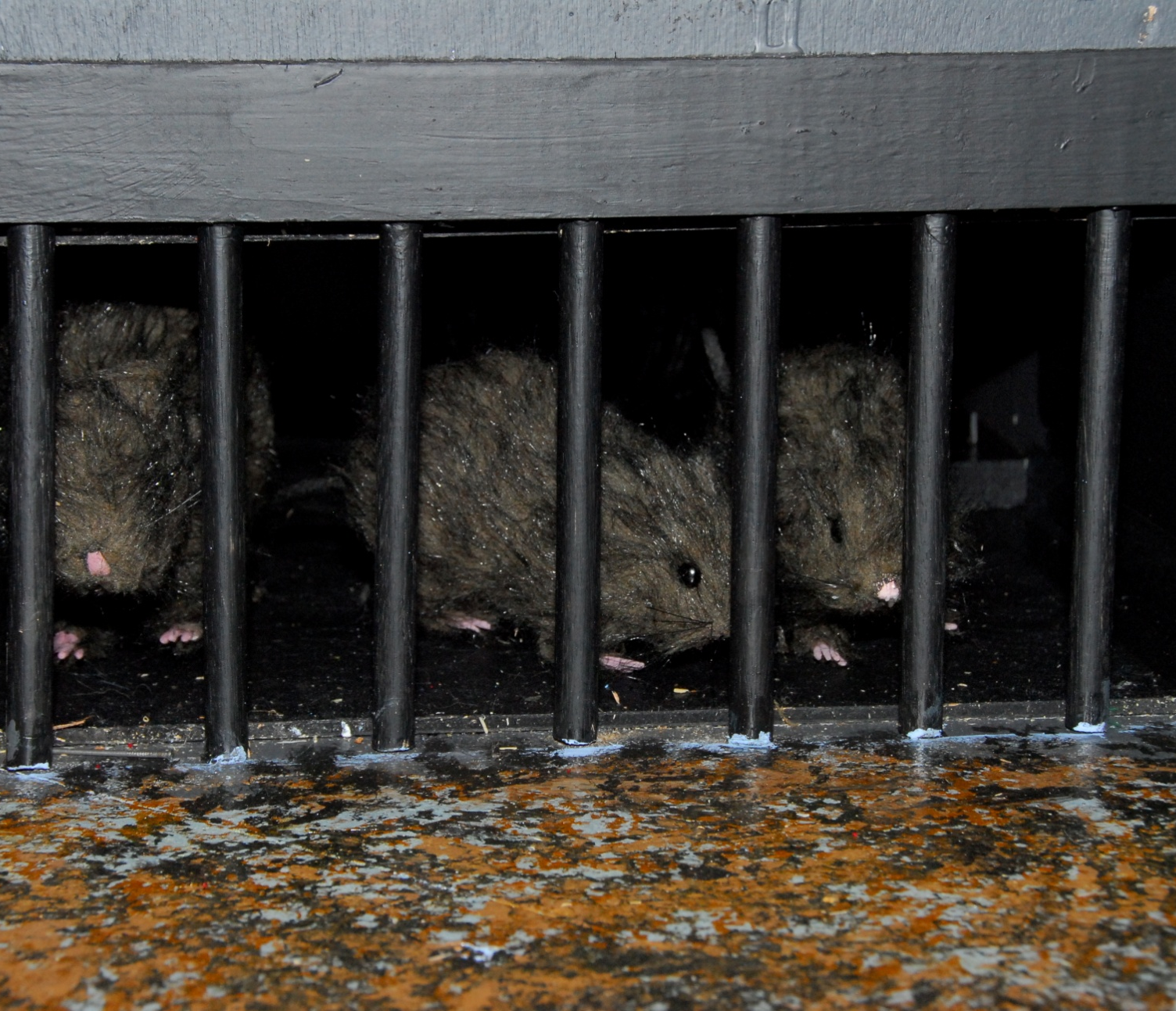
PRODUCTION CONCEPT
THE ELEPHANT MAN
SHAPE
Rectangles were the primary geometric shape and could be seen throughout the set, costumes, lights and props.
Thus creating unity and harmony.

Slide 39
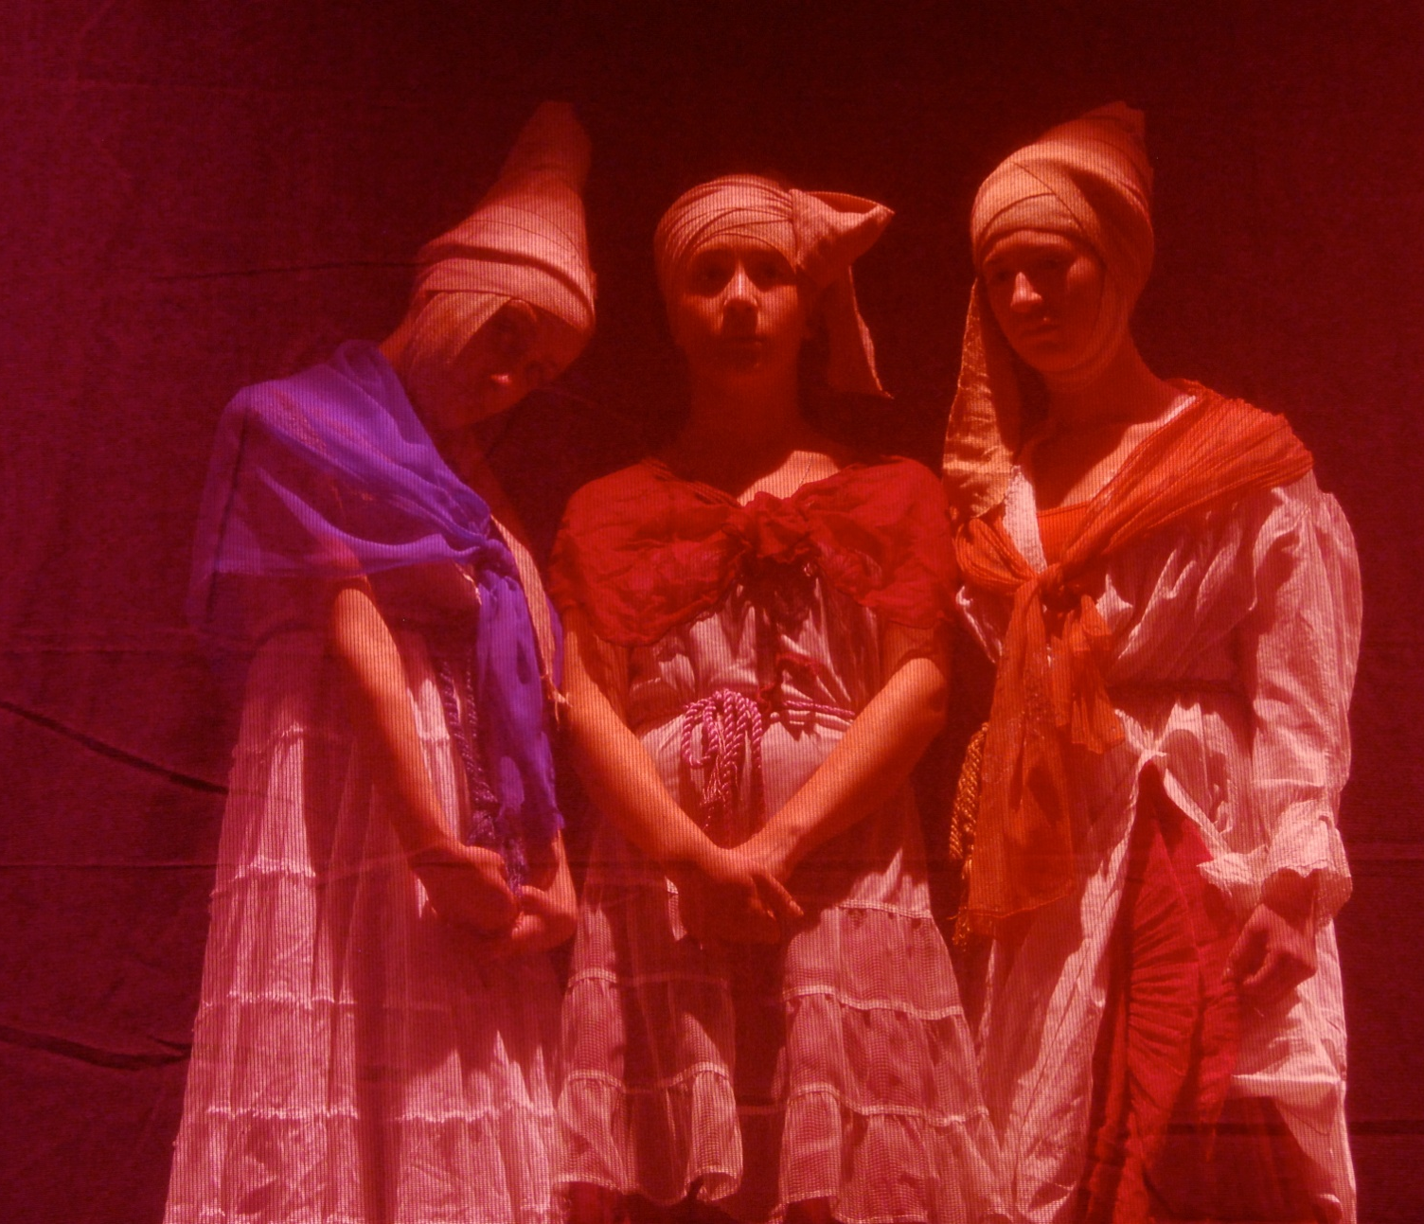
LINE, SHAPE, COLOR
THE ELEPHANT MAN
The PINHEADS represent the dreams and anxieties inside the mind of the Elephant Man.
Their heads are shaped like cones (geometric shape) - a shape that is obscure, long and pointed; not quite round; not perfect – like Merrick.
They wear white to represent the innocence of Merrick, while each is emphasized with a color to bring in the outside world.
Notice the dresses are trimmed with horizontal lines.

Slide 40
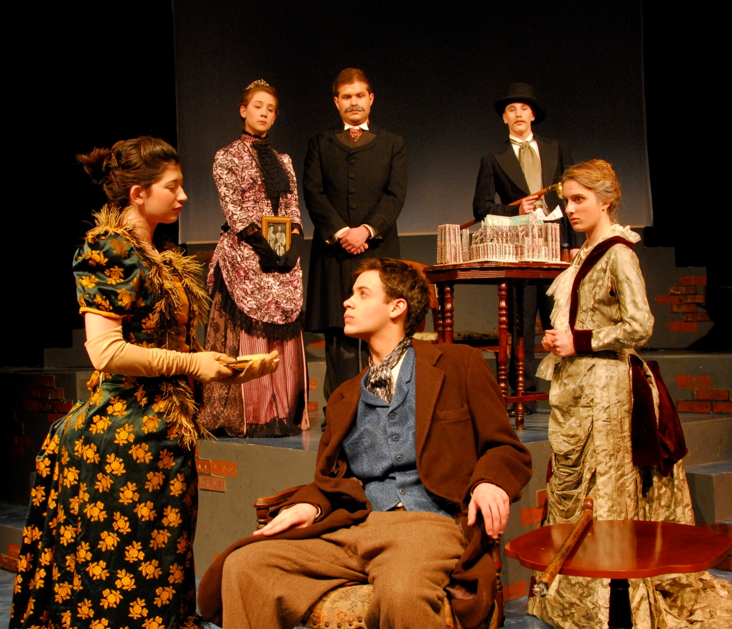
CONTRAST, VARIATION & EMPHASIS
THE ELEPHANT MAN
Floral patterns and curves can be seen in the costumes of the women of royalty.
As they represent the outside world of would could be, their costumes contrast to the rigid lines of the rest of the concept and allow them to also have emphasis as they stand out more as well. These patterns also give variation to the overall design.

Slide 41
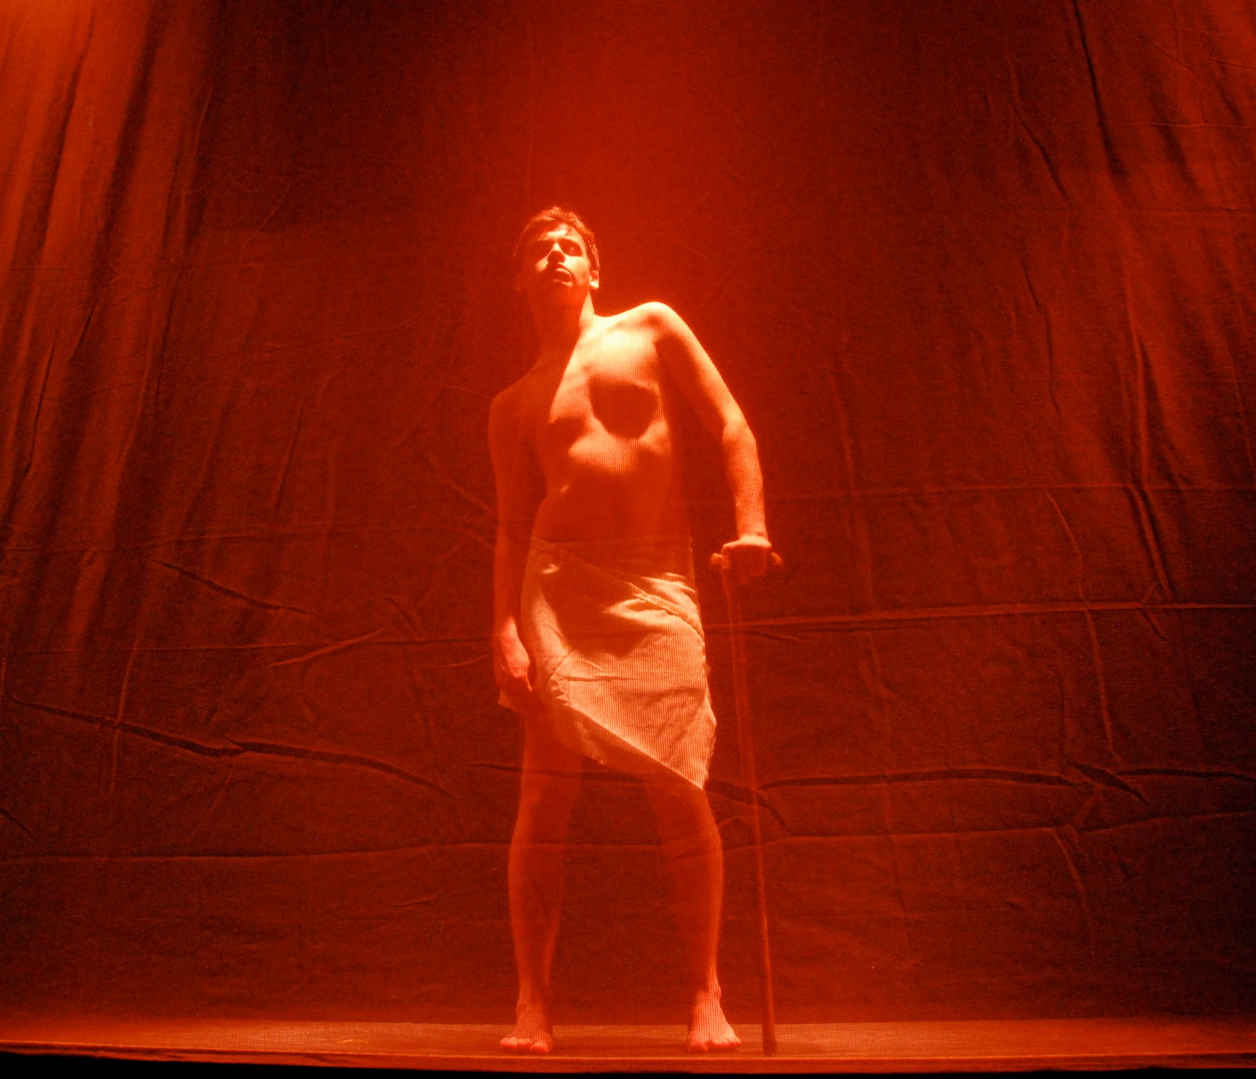
EMPHASIS & SHAPE
THE ELEPHANT MAN
EMPHASIS was placed on Merrick with SOFT back light as he was seen for the first time by Treeves during the Freak show. This also creates a soft silhouette of him.

Slide 42
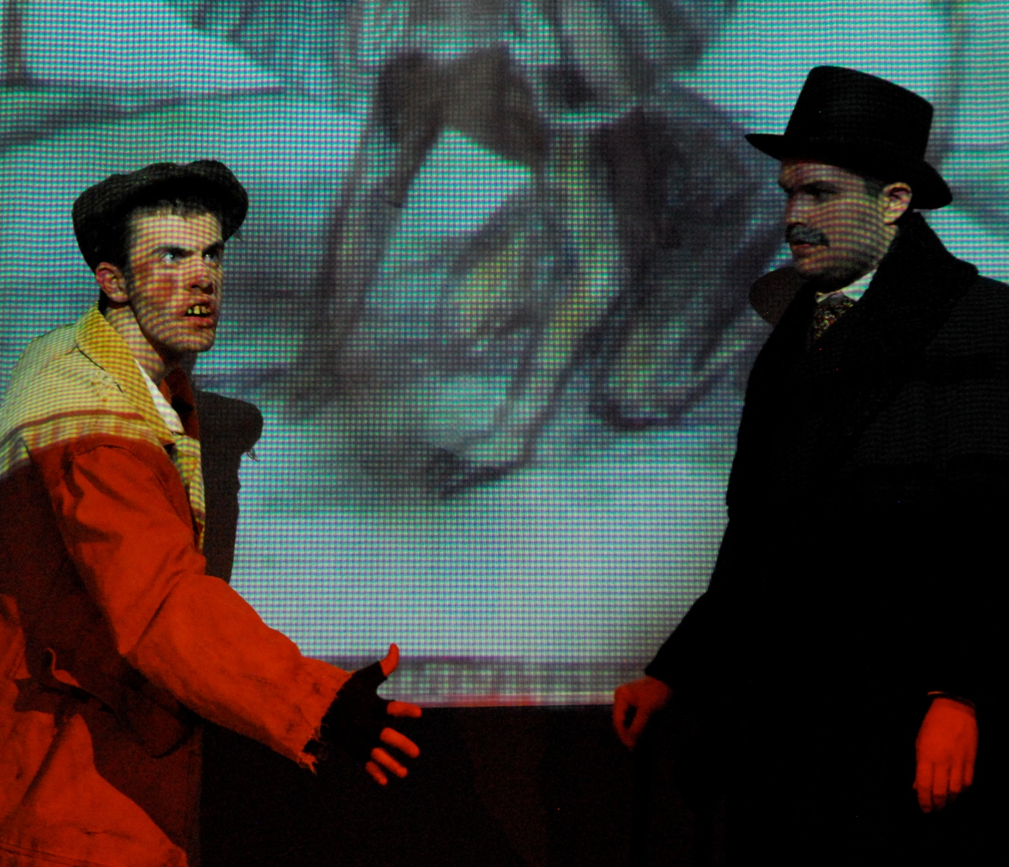
CONTRAST
THE ELEPHANT MAN
The dirty, greasy hair, dirty face, buck teeth and bug eyes helped to give CONTRAST to this dark sinister character, making him stand out from the rest.

Slide 43
PRODUCTION CONCEPT PAPER
TITLE
Production Concept Paper for the play ________(underline title)
PAPER ( typed, double spaced, 12 font size, times new roman)
1st P: Identify the play and author and give a brief plot summary.
2nd P: Explain the THEME and IDEA. Cite specific examples from the play. Include any psychological statements, as well relating the THEME and IDEA to the title of the play.
3rd P: Identify the production concept as a result of the prior paragraph (theme/idea)
4th P: Explain how the Elements of Design are represented in in visual elements which reflect the production concept.
5th P: Explain how the Principles of Composition are represented in in visual elements which reflect the production concept.
4&5 - (Do NOT give specific examples but only general representations for each)
6th P: Conclusion: Restate the theme/idea with the concept.

